Slide 1

Helping People In Need
Cerberus - ”The Ultimate Service Providers' Marketplace”

Slide 2
Discussion Topics:
Team Members
Mission Statement
Why a Marketplace?
Veteran Services
Elderly Services
Disabled Services
Cerberus Marketplace Use
Cerberus Marketplace Flow Chart
App Presentation

Slide 3
Cerberus Creators
Devin Humphrey – Project Manager/Pseudo-code/Flowchart/Debugger/Presenter
Dylan Danner – Adobe XD
James Galloway – Power Point

Slide 4

Mission Statement:
Primary goals for this application is to provide a competitive honest marketplace full of services for the everyday needs of the following demographics; Veterans, Seniors, and the Disabled.
~Ultimately making a difference that will impact their lives in the present and future to come!~
VETERANS
SENIORS
DISABLED

Slide 5



Why provide a marketplace for services specifically for veterans, seniors, and the Disabled in the Mountain Home and Local Areas?
The Cold Hard Facts:
Rated one of the top places to retire
Estimated Senior Citizen Population is around 4,053 out of 12,457
Estimated 1,246 Veterans
Estimated 8.2% of the local area population has a disability or impairment of some kind
Estimate Population Growth Rate of 1.2%
Estimated Annual Income Growth Rate of 3.49%
Areas Largest Industries: Health Care & Social Assistance, Retail, and Manufacturing

Slide 6

Veterans: Young, Old, or disabled
We support our veterans from all walks of life and would like to thank them for there service. This marketplace will allow them to conveniently find numerous services for the following but not limited too:
Building or Modifications to living quarters for your individual needs, Examples:
Building a ramp for a wheelchair
Residential Remodeling
Lawn Care
Living Assistance and Medical Care Transportation

Slide 7

Senior citizens
We offer a marketplace entrenched with service providers to senior citizens with tender loving care and that consist of the following:
Living Assistance Services
Transportation Needs
Lawn care, Plumbing, Electrical, Roofing, Construction Projects to assist with your everyday needs

Slide 8

Disabled individuals
We offer a marketplace connecting service providers with your everyday needs:
Plumbing
Electrical
Lawn & Landscape care
Living Assistance Services
Transportation needs

Slide 9
Typical use of Cerberus’s Marketplace:
Clients, can sign-up with a valid email address. After the initial sign up and verification of demographics have been confirmed by a third party, they will be able to sign in and enjoy a brief tutorial about the marketplace and its features. They will have the ability to filter, search, select, add, or remove services from the marketplace. After the services has been performed, they will be able to rate the merchant services from a scale of 1 (Horrible Service) to 5 (Outstanding Service) and add additional comments. This rating will be tied to the Merchants Marketplace Profile after the merchant has had a chance to review and dispute the rating if needed.
Merchants, can sign-up with a valid email address and a valid FEIN. After the initial sign up and verification of the business has been completed by a third party. The Merchant will enjoy a brief tutorial on setting up their services to be delivered to the marketplace clients. They will be able to add/promote/remove discounts, pay a small fee for priority advertisements that will stream when the clients visit the Marketplace. After the client completes the checkout, the merchant will receive an email notification with the client’s contact information and the services purchased. The merchant will have a chance to dispute the rating, the client has provided based upon factual evidence.

Slide 10
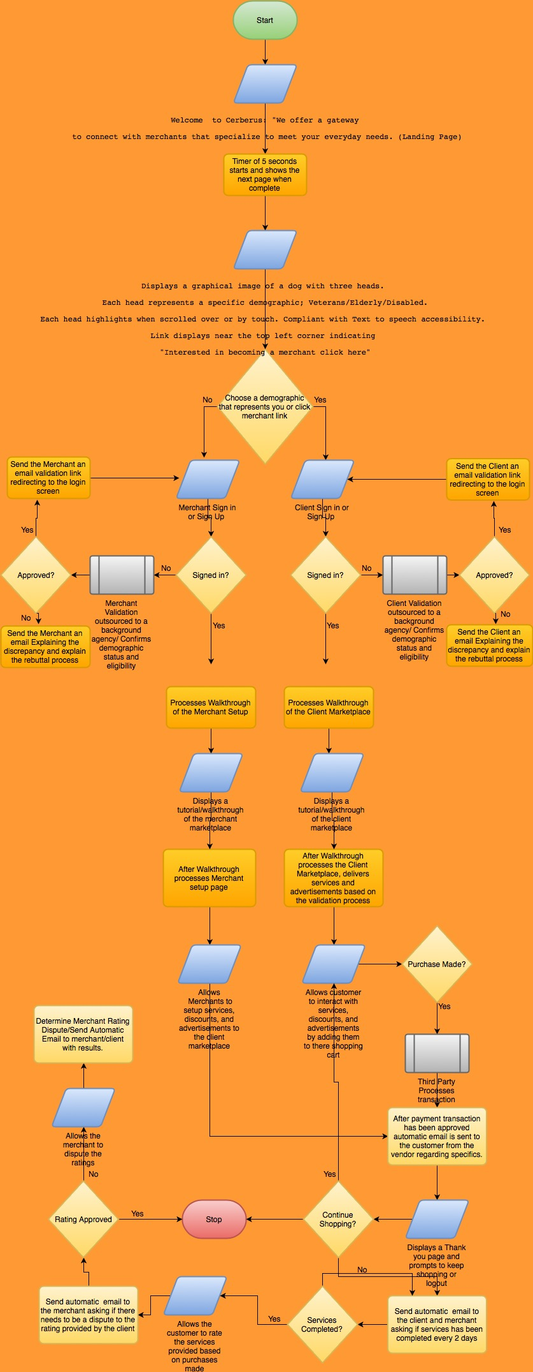
Cerberus’s flowchart
This flowchart allows us to see from the start of Cerberus’s main screen a walkthrough of the processes our clients and merchants will experience while visiting the Cerberus marketplace.

Slide 11

QUESTIONS?

